Slide 1
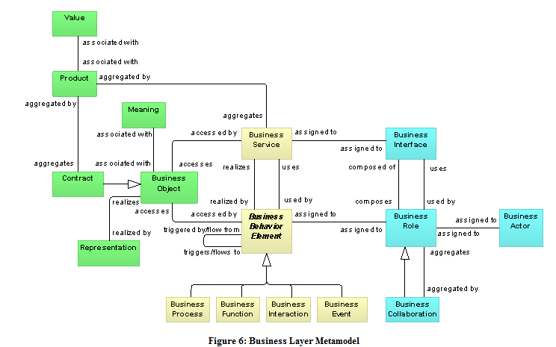
Archimate
Business Layer

Slide 2
Business Layer Metamodel

Slide 3
Structural Concepts
The active entities that are the subjects (e.g., business actors or business roles) that perform behavior such as business processes or functions (capabilities). Business actors may be individual persons (e.g., customers or employees), but also groups of people (organization units) and resources that have a permanent (or at least long-term) status within the organizations. Typical examples of the latter are a department and a business unit.

Slide 4
Structural Concepts
The passive entities (business objects) that are manipulated by behavior such as business processes or functions. The passive entities represent the important concepts in which the business thinks about a domain.

Slide 5
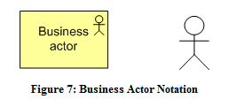
Business Actor
A business actor is defined as an organizational entity capable of (actively) performing behavior.

Slide 6
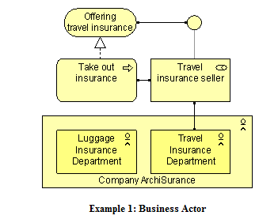
Business Actor Example
The company ArchiSurance is modeled as a business actor that is composed of two departments. The Travel insurance seller role is assigned to the travel department. In this role, the travel department performs the Take out insurance process, which offers a service that is accessible via the business interface assigned to this role.

Slide 7
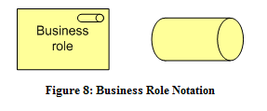
Business Role
A business role is defined as a named specific behavior of a business actor participating in a particular context.
Notes:
Business processes or business functions are assigned to a single business role with certain responsibilities or skills. A business actor that is assigned to a business role ultimately performs the corresponding behavior. In addition to the relation of a business role with behavior, a business role is also useful in a (structural) organizational sense; for instance, in the division of labor within an organization.
A business role may be assigned to one or more business processes or business functions, while a business actor may be assigned to a business role. A business interface or an application interface may be used by a business role, while a business interface may be part of a business role (through a composition relation, which is not shown explicitly in the interface notation). The name of a business role should preferably be a noun.

Slide 8
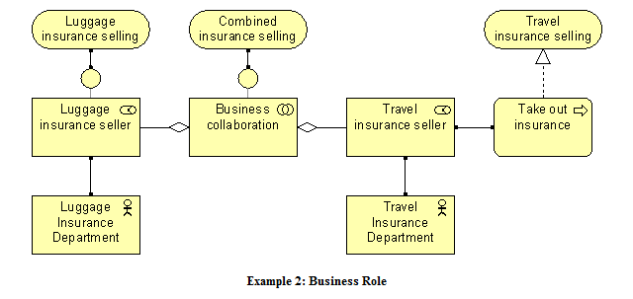
Business Role Example
In the model below, two business roles (Luggage insurance seller and Travel insurance seller) are involved in a collaboration that results in a Combined insurance selling service. The left hand illustrates the delivery of a Luggage insurance selling service via a business interface. The right hand shows how a business process, Take out insurance, is assigned to the Travel insurance seller and realizes the Travel insurance selling service.

Slide 9
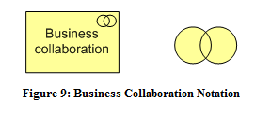
Business Collaboration
Business collaboration is defined as a (temporary) configuration of two or more business roles resulting in specific collective behavior in a particular context.
Notes:
A business process or function may be interpreted as the internal behavior assigned to a single business role. In some cases behavior is the collective effort of more than one business role; in fact a collaboration of two or more business roles results in collective behavior which may be more than simply the sum of the behavior of the separate roles. Business collaborations represent this collective effort. Business interactions are used to describe the internal behavior that takes place within business collaboration. A collaboration is a (possibly temporary) collective of roles within an organization which perform collaborative behavior (inter­actions). Unlike a department, which may also group roles, a business collaboration does not have an official (permanent) status within the organization; it is specifically aimed at a specific interaction or set of interactions between roles. However, a business collaboration can be regarded as a kind of “virtual role”, hence its designation as a specialization of role. It is especially useful in modeling B2B interactions between different organizations.
A business collaboration may be composed of a number of business roles, and may be assigned to one or more business interactions. A business interface or an application interface may be used by a business collaboration, while a business collaboration may have business interfaces (through composition). The name of a business collaboration should preferably be a noun. It is also rather common to leave a business collaboration unnamed.

Slide 10
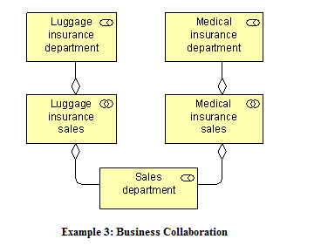
Business Collaboration Example
The model in the model below illustrates a possible use of the collaboration concept. In this example, selling an insurance product involves the Sales department and a department specialized in that particular type of insurance. The example also shows that one role, in this case the Sales department, can participate in more than one collaboration.

Slide 11
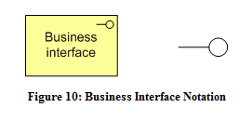
Business Interface
A business interface declares how a business role can connect with its environment.
Notes:
A business interface specifies how the functionality of a business role can be used by other business roles (provided interface), or which functionality the business roles requires from its environment (required interface). A business interface exposes a business service to the environment. The same business service may be exposed through different interfaces.
A business interface may be part of a business role through a composition relation, which is not shown in the standard notation, and a business interface may be used by a business role. A business interface may be assigned to one or more business services, which means that these services are exposed by the interface. The name of a business interface should preferably be a noun.

Slide 12
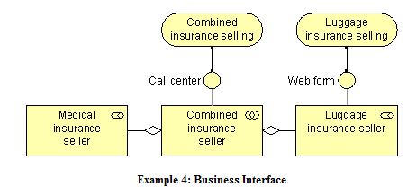
Business Interface Example
In the model below, the business services provided by the Luggage insurance seller and its collaboration with the Medical insurance seller are exposed by means of a web form and call center business interface, respectively.
Notes:
A business interface specifies how the functionality of a business role can be used by other business roles (provided interface), or which functionality the business roles requires from its environment (required interface). A business interface exposes a business service to the environment. The same business service may be exposed through different interfaces.
A business interface may be part of a business role through a composition relation, which is not shown in the standard notation, and a business interface may be used by a business role. A business interface may be assigned to one or more business services, which means that these services are exposed by the interface. The name of a business interface should preferably be a noun.

Slide 13
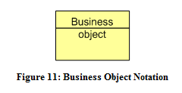
Business Object
A business object is defined as a unit of information that has relevance from a business perspective.
Notes:
Business objects represent the important “informational” or “conceptual” elements in which the business thinks about a domain. Generally, a business object is used to model an object type (cf. a UML class), of which several instances may exist within the organization. A wide variety of types of business objects can be defined. Business objects are passive in the sense that they do not trigger or perform processes.
A business object may be accessed (e.g., created, read, written) by a business process, function, a business interaction, a business event, or a business service. A business object may have association, specialization, aggregation, or composition relationships with other business objects. A business object may be realized by a representation or by a data object (or both). The name of a business object should preferably be a noun.

Slide 14
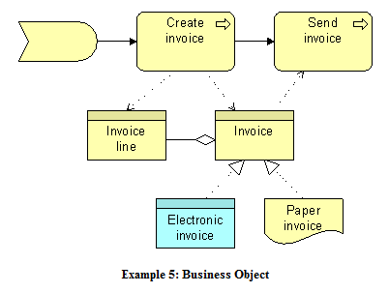
Business Object Example
The model below shows a business object Invoice, which aggregates (multiple) business objects Invoice line. Two possible realizations of this business object exist: an Electronic invoice (data object) and a Paper invoice (representation). The business process Create invoice creates the invoice and the invoice lines, while the business process Send invoice accesses the business object Invoice.

Slide 15
Behavioral Concepts

